Slide 1
A GUI Example Using Python

Slide 2
Instructor – Ray Smith raysmith@alum.mit.edu
Many years of Programming – engineering, scientific, financial
Commercial, Scientific, Systems Languages – C, C++, Perl, Java, Python, Assembly
NEW Areas - Games for young 3-8 years
Notes:
What would you like to know about me?

Slide 3
Objectives
Sample Graphic User Interface (GUI)
Demonstrate Operations and Methods
Show ideas / issues behind GUI Software
Notes:
What do you want from this course?
What do you want from programming?

Slide 4
Our Online Session – Using Zoom
If any background noise, please mute – minimizes cumulative noise
Disable own video – too many reduces clarity
Can question via Chat – can be to ALL
Expecting Response: Start "QUESTION:"
Notes:
What do you want from this session?
What do you want from programming?

Slide 5
Approximate Session Layout
Lecture and Demonstration: 1.5 Hours
Follow-up Questions: .5 Hours

Slide 6
Featured Example – Keyboard Drawing Program Target Audience: Children 3-8 Years Old
Limited – Non-production
On GitHub: raysmith619
Program: keyboard_draw
Support: resource_lib
https://github.com/raysmith619/keyboard_draw

Slide 7
Keyboard Drawing Program Features / Attributes
Totally keyboard driven (can be)
Simultaneous screen keyboard simulation / display
Adjustable screen keyboard size
Line, Shape, Letter, Image Markers
Simple undo (no redo yet)

Slide 8
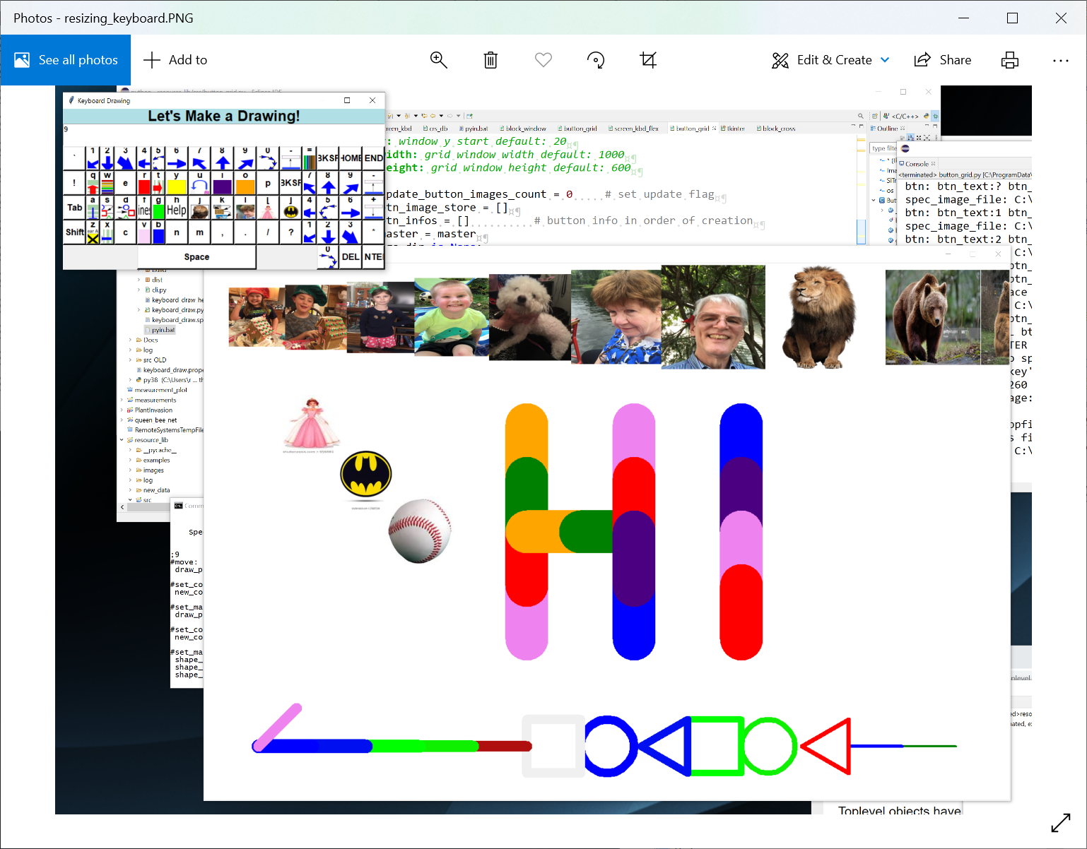
Screen Shot

Slide 9
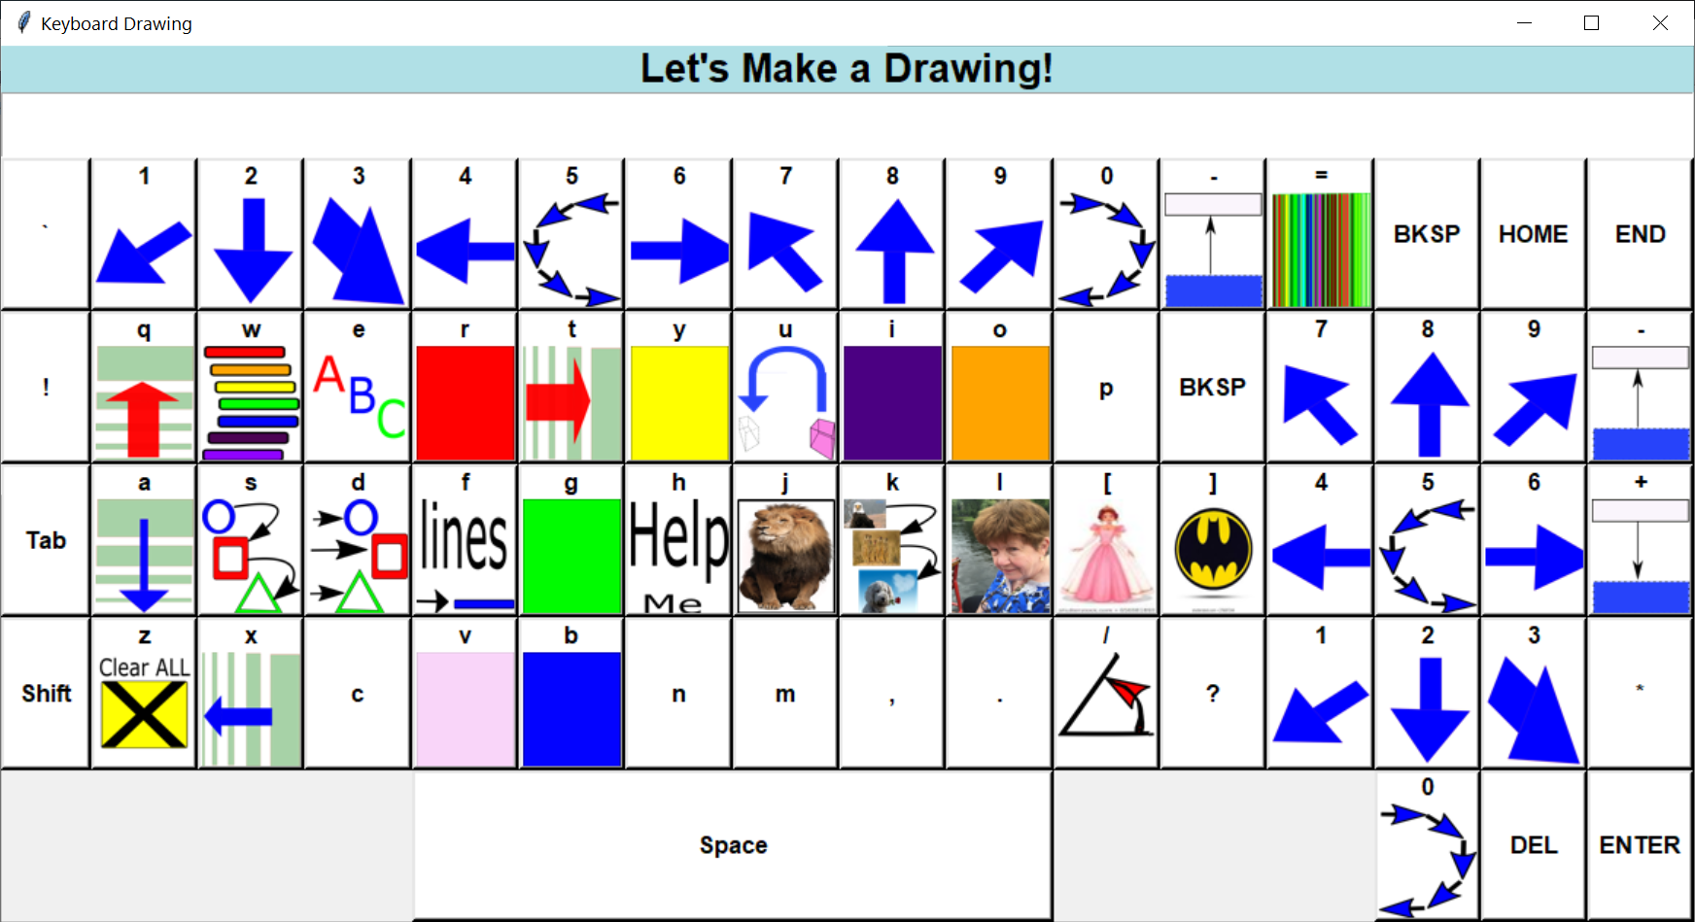
Keyboard Screen – Figure mode

Slide 10
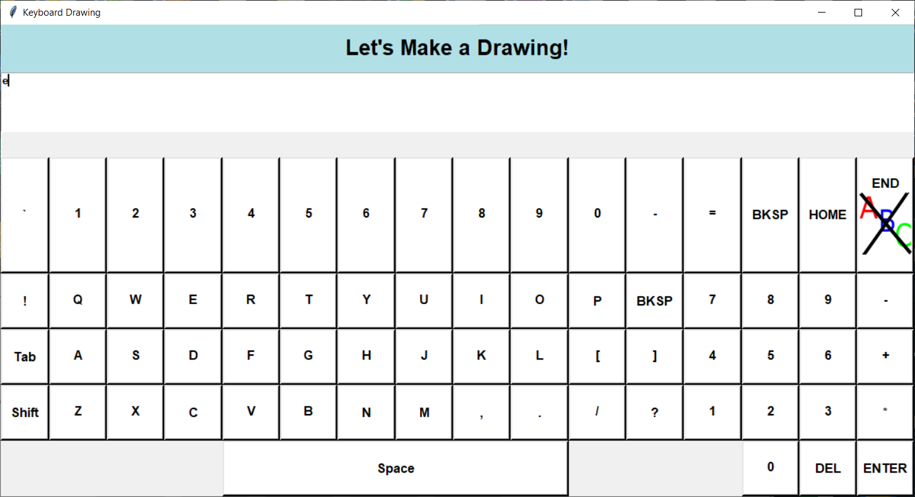
Keyboard Screen – Text mode

Slide 11
Keyboard Draw Program Structure
Main program – keyboard_draw.py
Drawing canvas – turtle and tkinter
Screen keyboard – no turtle
resource_lib/src/screen_kbd_flex.py
resource_lib/src/button_grid.py
Image file support resource_lib/…
Notes:
Started with screen_kbd.py – no support for size changing

Slide 12
Some Issues
Mixed support turtle vs tkinter
turtle, a powerful graphics tool
tkinter full graphics interface
Mixed turtle and tkinter has issues
Undo limited and more complicated

Slide 13
Some Issues - continued
Figure Modification, e.g. rotate figure
Figure built in rotation vs. undo, redo with changed parameter(new heading)

Slide 14
Detailed Walk Through the Code Mostly Bottom Up
Keyboard layout – Buttons…
button_grid.py
ButtonGrid n row by m column buttons
Button – text or text plus image
Adjustable size – buttons (and images) resize
Internal key attribute list
Enable / Disable button image display

Slide 15
ScreenKbdFlex – screen keyboard screen_kbd_flex.py
Full keyboard
Title
Echoed text region
ButtonGrid – keys
Returns clicked key – onkbd()
Internal key attribute list
Enable / Disable button image display

Slide 16
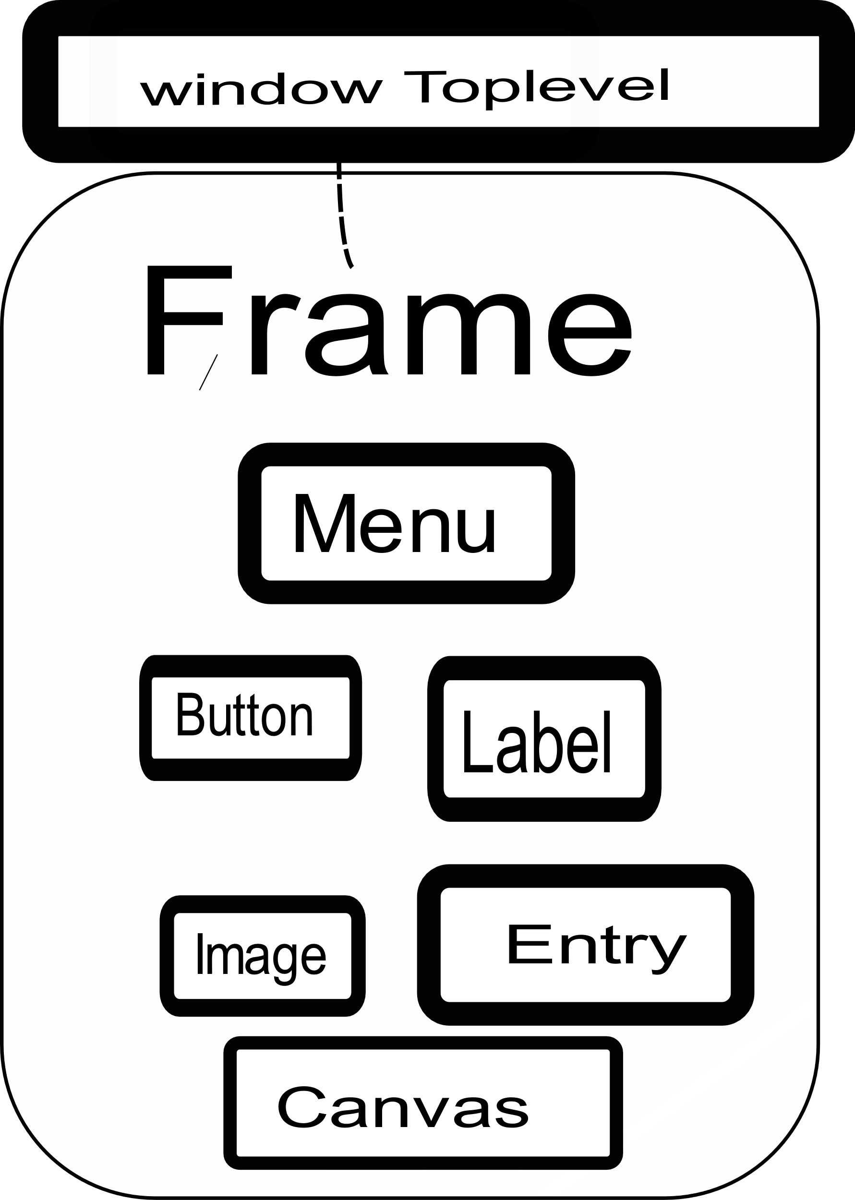
Python tkinter Display Structures – simplified
Notes:
Very similar support found in Python, Java, C++, Perl
Many more widgets

Slide 17
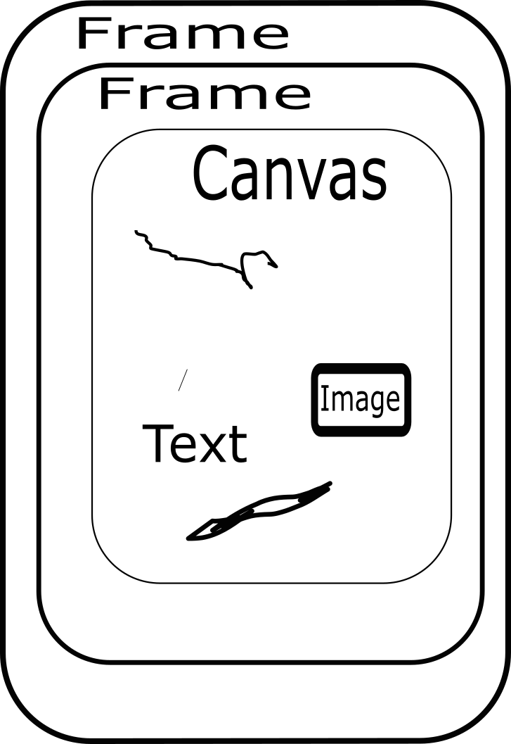
Python tkinter Display Structures – continued Drawing Support

Slide 18
Python tkinter - Event Driven
Program is a loop – mainloop()
Events ←→ Call backs
widget.bind(<event>, callback)
keybd_frame.bind('<Configure>', self.win_size_event)
btn = Button(key_frame, …, command = (lambda x =
btn_text: self.buttonClick(x)))

Slide 19
ButtonGrid Goals / Design / Hopes button_grid.py
General keyboard grid
Keys – Text and or Images
Resizable
Dynamic change, especially images

Slide 20
ButtonGrid Code button_grid.py
Setup N by M button grid
__init__()
keys: list of keys to display
key_attrs: key attributes – with image_file or other special attributes

Slide 21
ButtonGrid Code - continued button_grid.py
Use "grid" geometry for key layout
Each button uses Button widget
Button with image uses "small_image" for keys with no image

Slide 22
Undo / Redo / Repeat – Gaming Issues
People make mistakes – want an easy second chance
Common concept – Most GUIs Provide

Slide 23
Undo - continued
Undo – go back to the past
Redo – an Undo for the Undo
Repeat – sort of a Redo for the future
More than one type – moves, settings, levels
Want depth

Slide 24
Undo - continued
Before: Save the state
After: Restore the state
OR
Before: Save the change
After: Undo the change
Notes:
Why one over the other?
Amount of context

Slide 25
Undo - continued
What is the state?
What is the change?
Notes:
Moves within moves?
Continuous changes

Slide 26
Undo via Command Pattern
Design Patterns - Gamma, Helm, Johnson, Vlissides
Behavior Pattern – a Request
Facilitate Undo, Redo, Repeat, Scripting

Slide 27
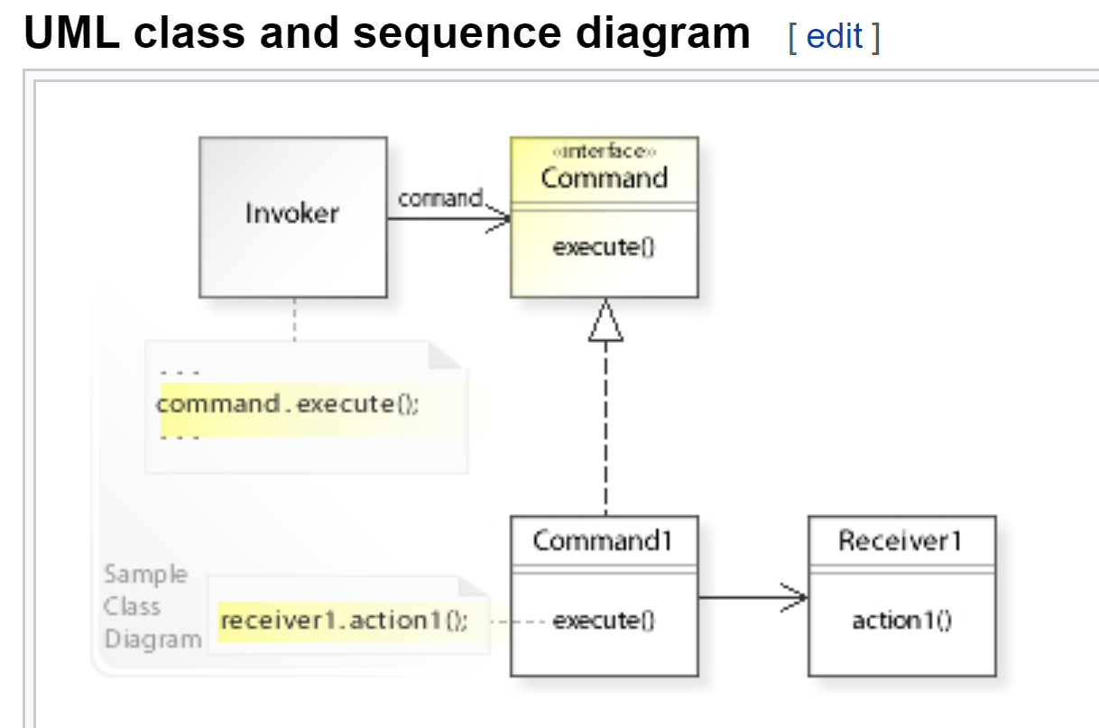
Command Pattern – UML diagram from Wikipedia

Slide 28
Command – code/data structure
class DrawingCommand:
def __init__(self, action):
set_drawing_controller()
self.prev_markers = []
self.new_markers = []
self.prev_loc = self.drawing_controller.cmd_get_loc()
self.new_loc = None # New loc (x,y) self.prev_heading = self.drawing_controller.heading
self.heading = None # New heading

Slide 29
Command – member functions
class DrawingCommand: …
def undo()
def redo()
def repeat()
def execute()
def do_cmd()
def copy()

Slide 30
Command – undo function
Remove most recent command
Was poped off of command_stack
Make command copy
Reverse requests in copy
Execute command copy
If OK add command onto undo_stack
If OK return True

Slide 31
Command – do_cmd function used by redo, repeat, normal execution
Execute command
If OK, and can undo, push cmd onto command_stack

Slide 32
Command – redo function
command_manager has already popped command from undo stack
If can redo, call do_cmd()

Slide 33
Command – repeat function
Make command copy
Make reasonable changes
Call new_cmd.do_cmd()
Notes:
What are reasonable changes?
What happens if no changes are made?

Slide 34
Command Manager – why / what
Manage the stacks
Top level control
Notes:
What are reasonable changes?
What happens if no changes are made?

Slide 35
Command Manager – undo
Check if can undo
Pop cmd off command_stack
cmd.undo()
Notes:
What are reasonable changes?
What happens if no changes are made?

Slide 36
Command Manager – redo
Check if can redo
Pop cmd off undo_stack
cmd.redo()
Notes:
What are reasonable changes?
What happens if no changes are made?

Slide 37
Command Manager – repeat
Check if can repeat
Take cmd off command_stack, NO POP
cmd.repeat()
Notes:
What are reasonable changes? A small displacement so user can recognize a duplicate
What happens if no changes are made?

Slide 38
Developing a Command based Gaming Architecture
Decide on Unit of Play
Figure/marker
Level of operation/command
Command containing markers
Make Program Partitions
Display, Command, …
Notes:
In my 3D modeler units are blocks

Slide 39
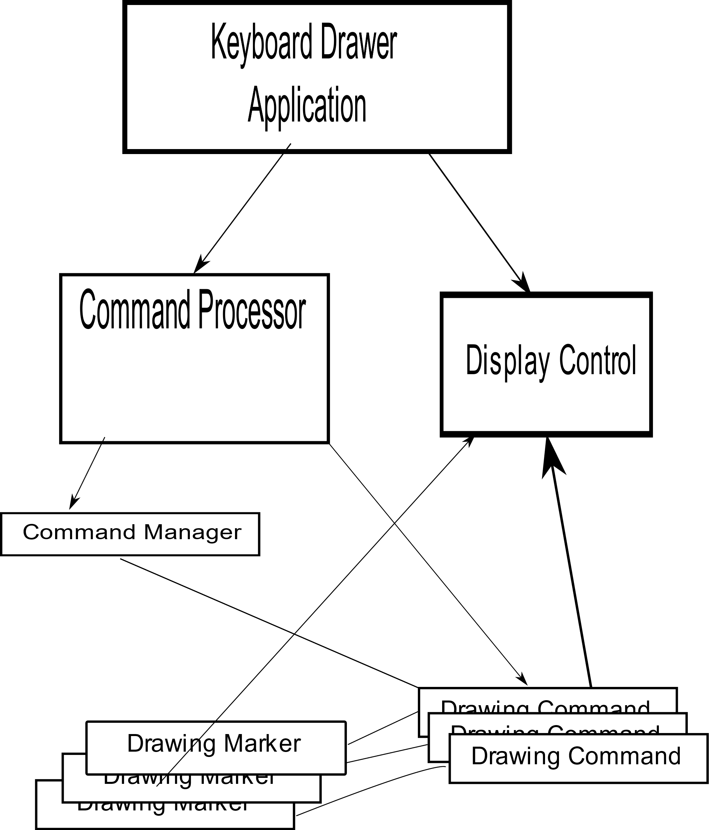
Program Structure

Slide 40
Marker – Responsible for Picture Part
Attributes – Size, Color, Location, Orientation
Debugging – e.g., __str__()
Drawing – draw()
Interface
To Drawer ( e.g. canvas)
To other parts (e.g. copy)
Change requests

Slide 41
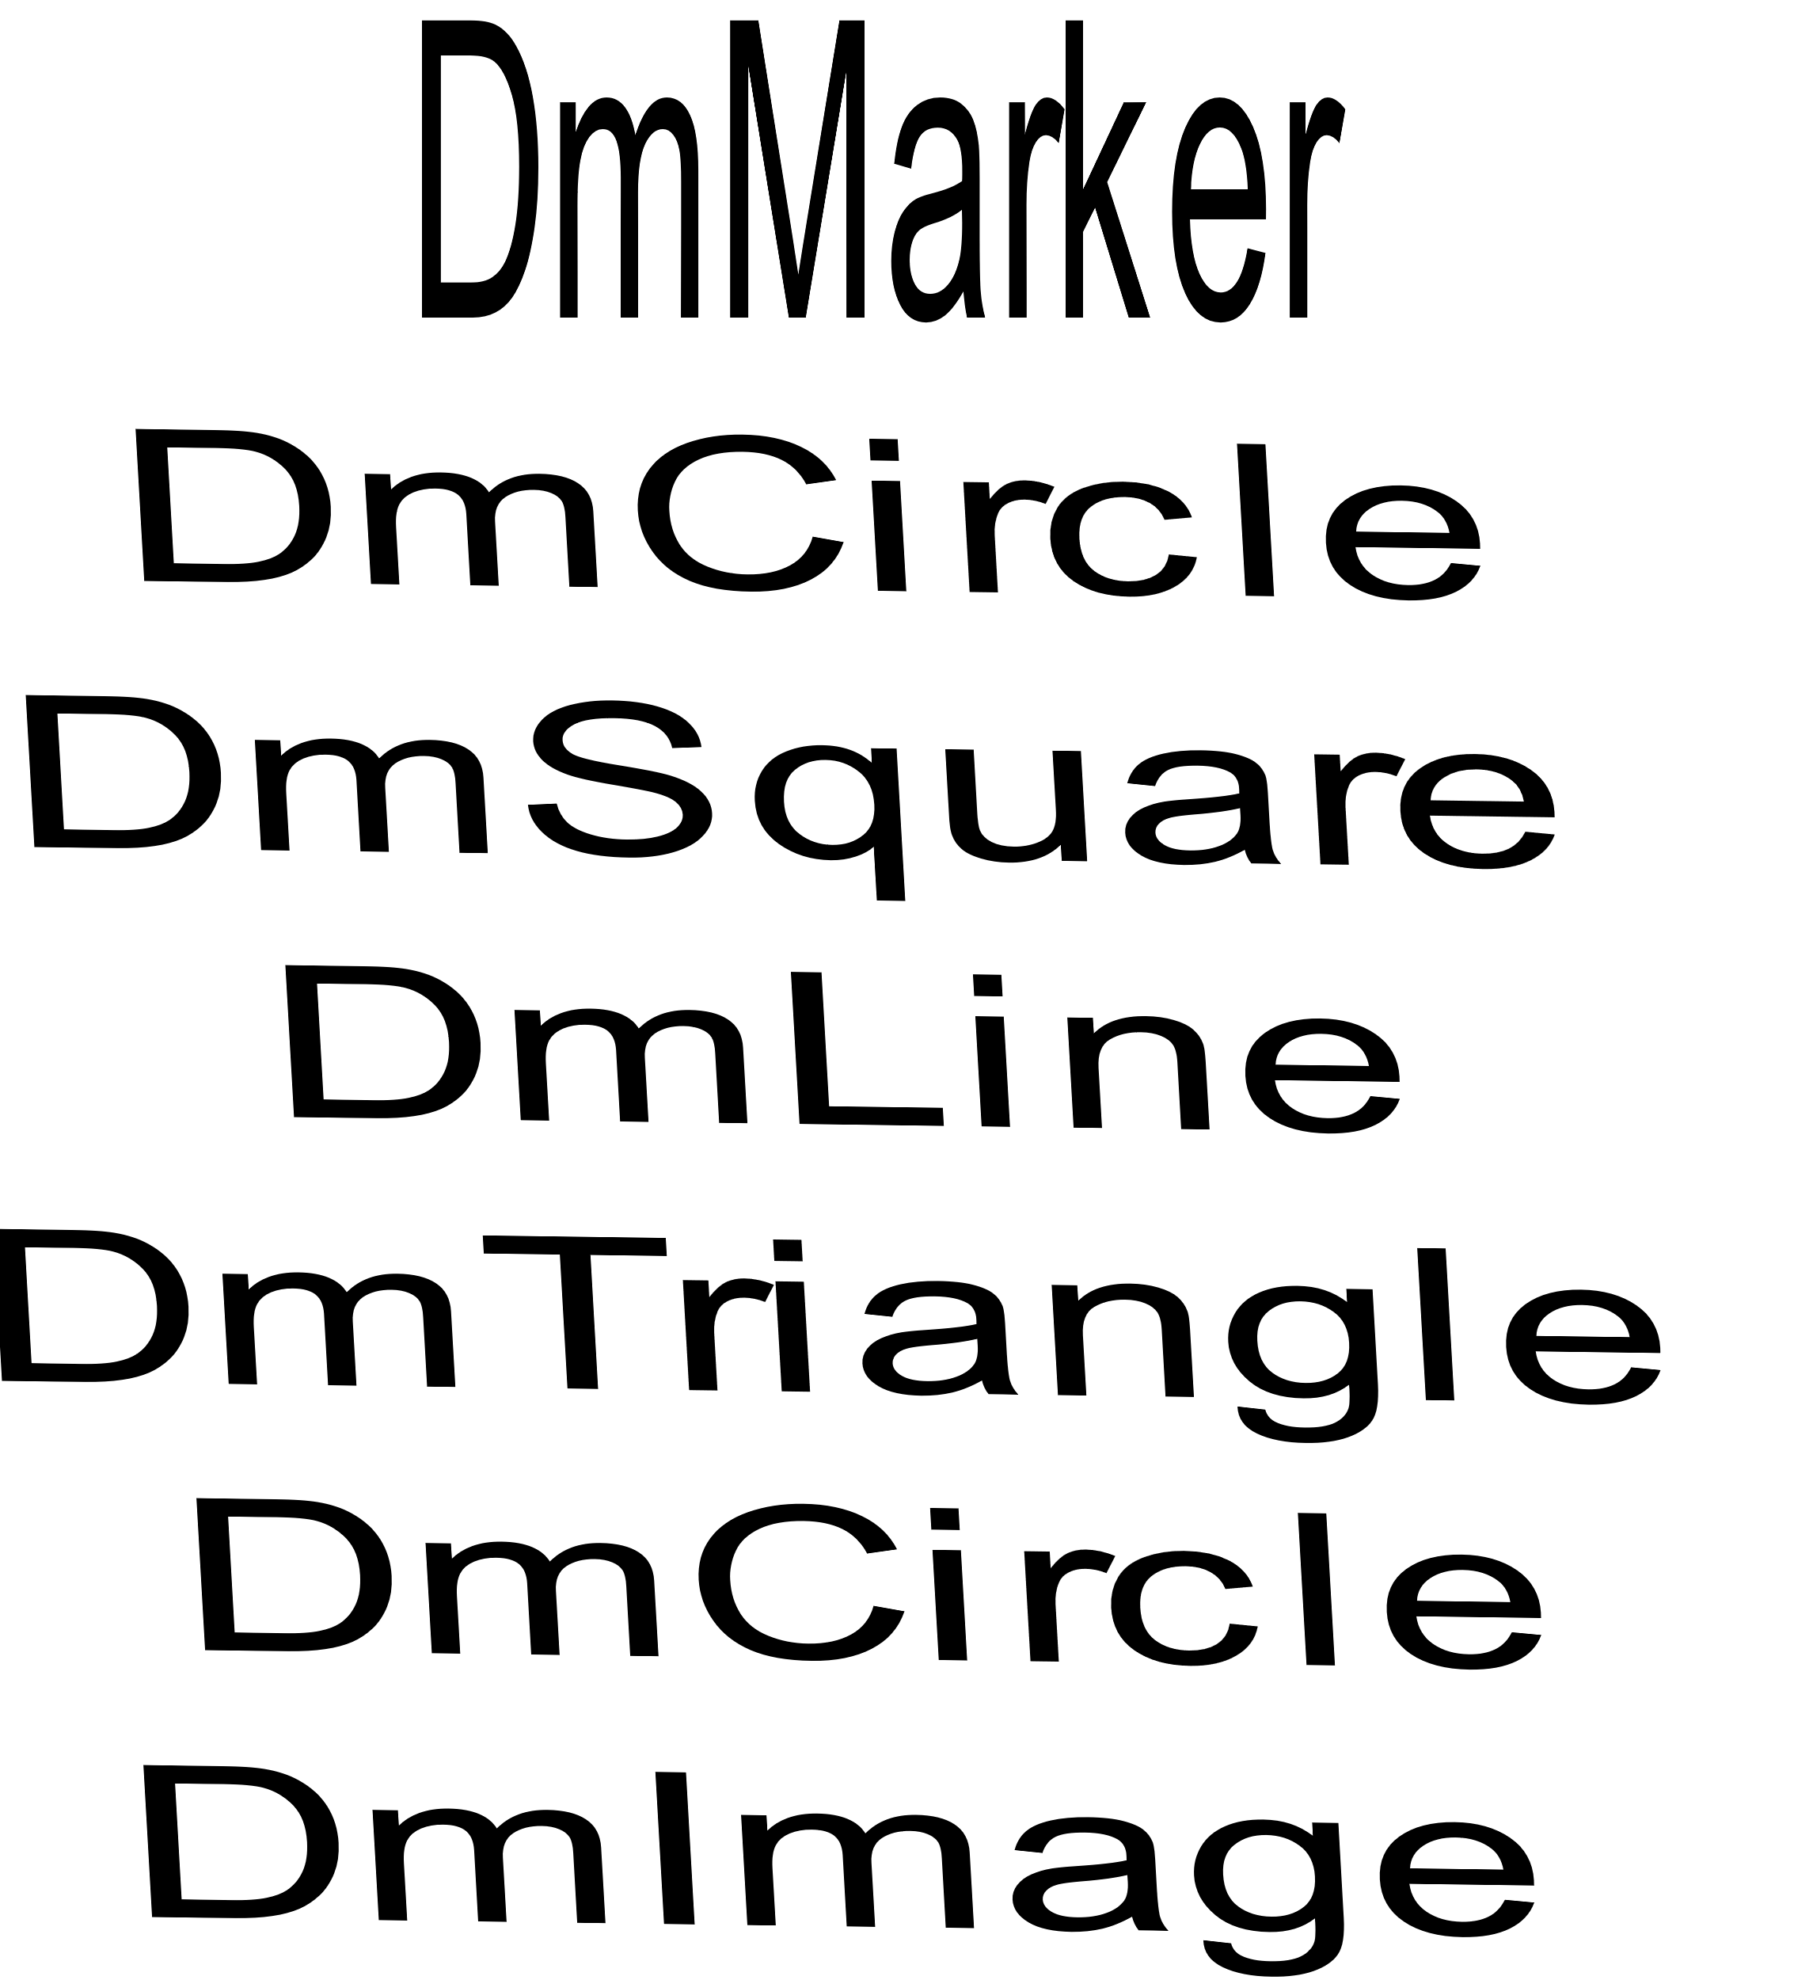
Marker – DmMarker – dm_marker.py, dm_....py

Slide 42
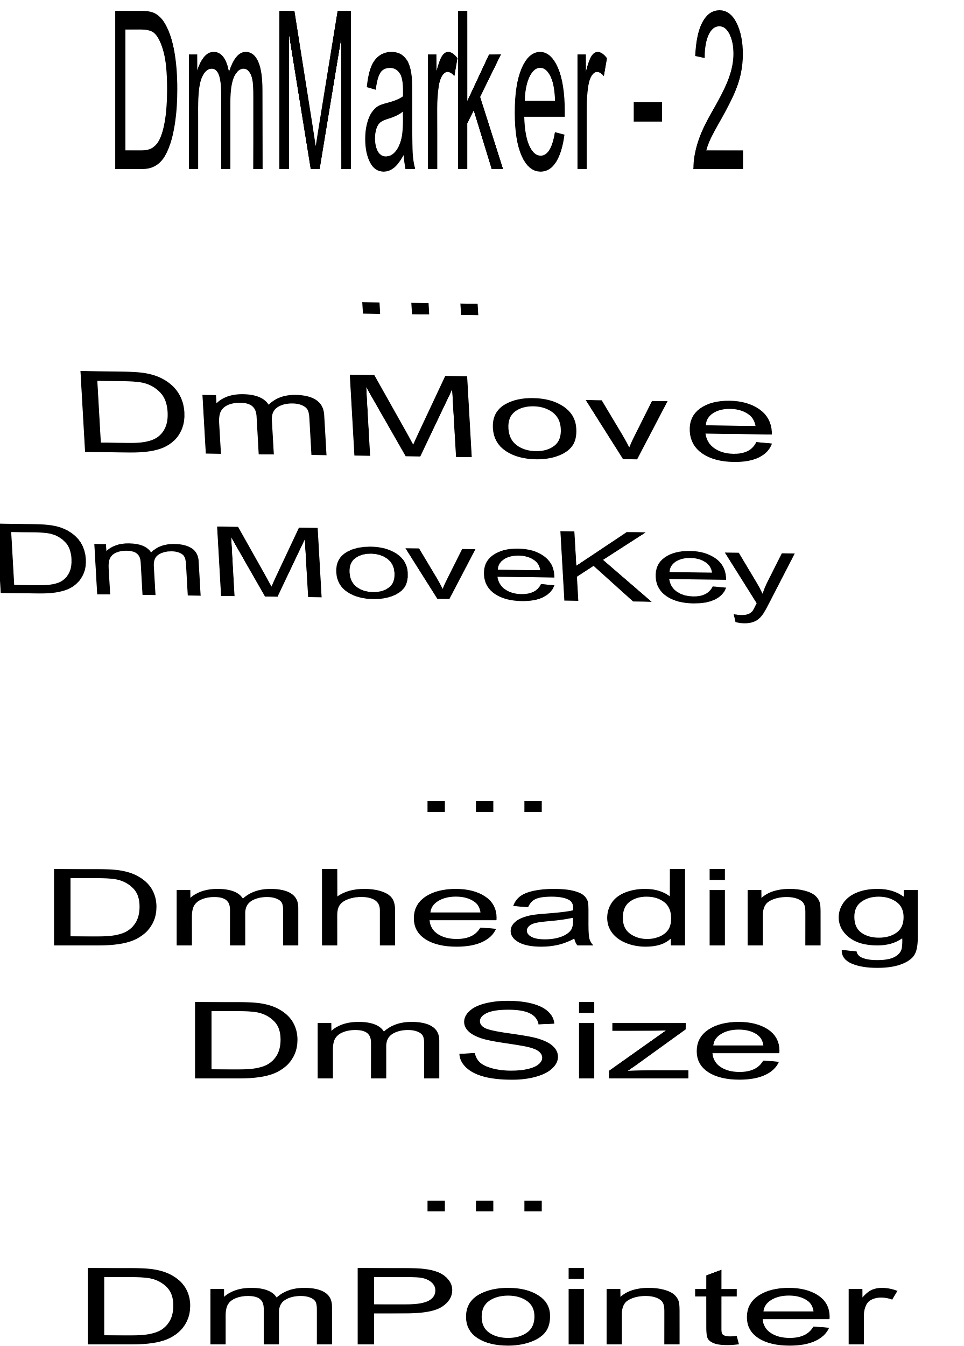
Marker – DmMarker – dm_....py

Slide 43
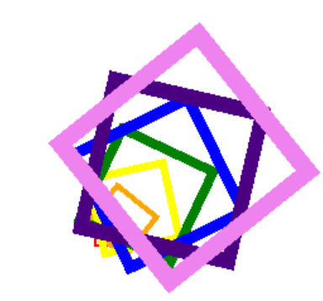
DmS quare – an example dm_square.py
Creation of a square
Based on DmMarker - Main attributes: side, heading, color
Self-test:

Slide 44
DmS quare – continued
__init__(…): setup attributes – passed to DmMarker
__str__(): debugging list attributes
__draw__(): add_square() - draw figure on canvas
add_square as well as others – in DmMarker to be available to others
Notes:
Lets look at a little code

Slide 45
DmDrawer – Drawing control sample
Centralized drawing control
Uniform interface to tkinter, drawing canvas
Bookkeeping for drawing, e.g. location, heading

Slide 46
DmDrawerImage – Drawing Images
Based on DmDrawer
Allows DmDrawer to be simpler
Access to image files

Slide 47
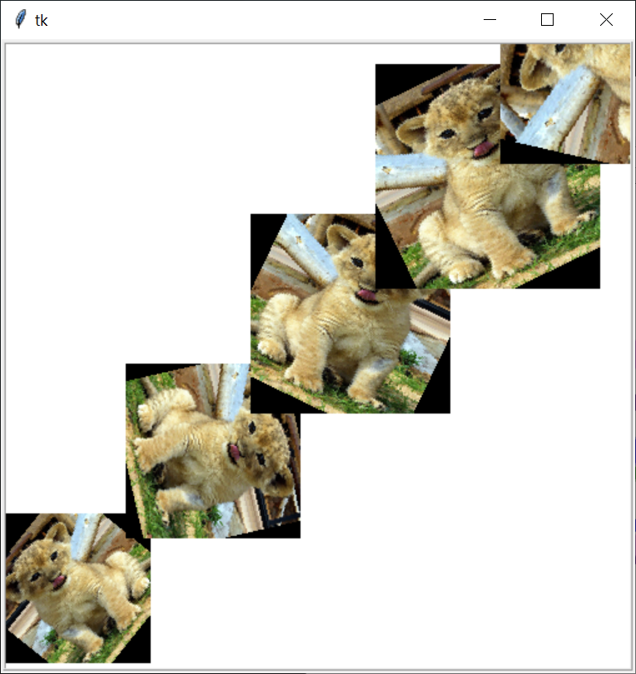
DmImage – Image Marker
From folders e.g. animals
Similar controls as other markers
Self-test:

Slide 48
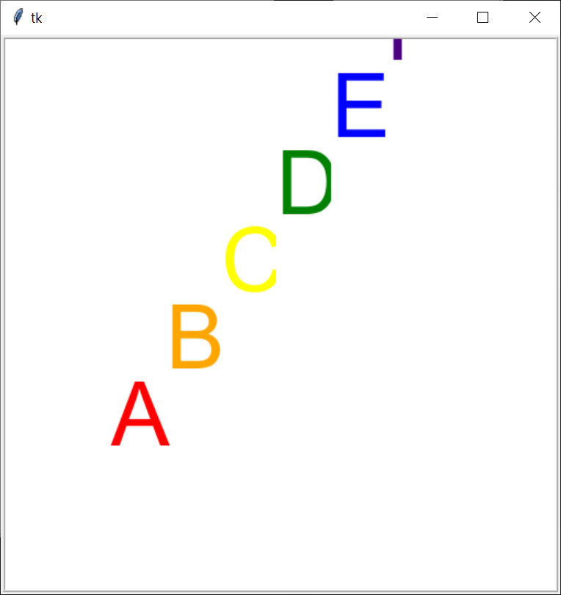
DmText – Text (Letter) Marker
Use images to facilitate rotation/scaling
Self-test:

Slide 49
A simple command – new shape
Key / button -- 's' – from:
Std keyboard
self.drawer.master.bind("<KeyPress>", self.on_key_press)
OR
Screen keyboard
Button(….) ➔ ButtonGrid() ➔ ScreenKbdFlex()

Slide 50
A simple command – new shape - continued
KbdCmdProc.do_keysym() ➔
drawing_cmd() ➔ graphical commands…
cmd_shapes() ➔
get_next("shape")
cmd_do_shape()
get_next("color")
marker = self.make_shape(shape=…)
…From previous create next shape

Slide 51
A simple command – new shape - continued
…From previous create next shape
mv_last = self.last_visible_marker()
cmd_last = self.last_command()
cmd = DrawingCommand("…")
self.cmd_undo() # Remove old - change in-place
marker_new = marker.use_locale(mv_last)
cmd.add_markers(marker_new)
cmd = cmd_last.use_locale(cmd_last)
cmd.do_cmd()
Notes:
We use last_command_marker() to get the last command which had a marker

Slide 52
A bit more complex – Repeat Command
Key / button – "space"
Repeat the most recent figure/marker
Moved by figure's size in current heading
Heading is changed to stay visible(mostly) by "bouncing" off edges
Can be done/undone

Slide 53
A bit more – Repeat Command - continued
KbdCmdProc.cmd_repeat() ➔
command_manager.get_repeat() – get repeat copy
do_cmd(cmd) – do command, adjusted direction

Slide 54
Command Manager: get_repeat()
def get_repeat(self):
""" Get copy which would, if executed,
repeat the last command"""
cmd = self.last_visible_command()
cmd_last = self.last_command()
cmd = cmd.use_locale(cmd_last) # Update for
# changes
return cmd.get_repeat()

Slide 55
A bit more – Repeat Command - continued
def do_cmd(self, cmd):
""" Do command, first checking for the edge. """
next_loc = cmd.get_next_loc()
if self.is_on_canvas(next_loc):
return cmd.do_cmd() # No change to cmd
if self.adj_movement(cmd):
return cmd.do_cmd() # Executed changed
return False # Can't execute

